Slide 1


DATA MODELING AND ANALYSIS:
UNVEILING TOP 5 PERFORMING CATEGORIES FROM MERGED DATASET

Slide 2


Today's agenda
Project recap
Problem
The Analytics team
Process
Insights
Summary

Slide 3

In this project, we embarked on a comprehensive data modeling and analysis journey, bringing together three essential tables—Reaction, Content, and Reaction Types. Through meticulous merging and strategic data consolidation, we created a refined dataset that encapsulates key information. Our subsequent focus involved calculating total scores for each category, resulting in a clear and concise list of the top 5 performing categories. This streamlined approach enhances data clarity and empowers data-driven decision-making, providing valuable insights for informed strategies in the analyzed dataset.
Project Recap

Slide 4

Problem
Data Integration Challenge for Social Buzz:
- Seamlessly merge data from Reaction, Content, and Reaction Types tables to create a unified dataset for analysis.
2. Performance Metrics Analysis for Social Buzz:
- Identify the top content categories and calculate reactions for the most popular category on the Social Buzz platform.
3. Temporal Analysis for Social Buzz:
- Determine the month with the highest post frequency on Social Buzz, offering valuable insights for strategic content planning.

Slide 5



The Analytics team

Slide 6
Process
1
ORGANISING THE DATA
2
DATA CLEANING AND MODELING
3
ANALYSING THE DATA
4
DERIVING THE INSIGHTS OF THE DATA
5
REPORT PREPARATION

Slide 7
Insights
How many unique categories are there?
Animals
science
healthy eating
technology
food
culture
travel
cooking
soccer
education
fitness
Studying
dogs
tennis
veganism
public speaking
There are 16 categories on which the users are posted their ideas. Among the categories animals, science, Healthy eating, technology and food are in the Top 5 positions respectively.

Slide 8
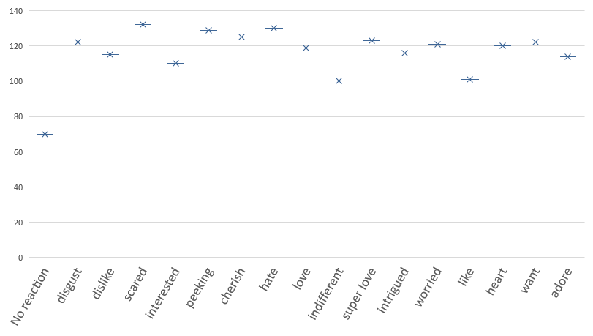
How many reactions are there to the most popular category?
1967 Reactions are recorded to the most popular category (animals).
Reaction type | No of reactions
No reaction | 70
disgust | 122
dislike | 115
scared | 132
interested | 110
peeking | 129
cherish | 125
hate | 130
love | 119
indifferent | 100
super love | 123
intrigued | 116
worried | 121
like | 101
heart | 120
want | 122
adore | 114
table that displays the count of different reaction types to the category "animals"

Slide 9
What was the month with the most posts?
Among the various months in the year the highest number of posts is posted in may month

Slide 10


INSIGHTS
In summary, May emerges as the peak posting month, indicating heightened user engagement on the Social Buzz platform.
The category "Animals" stands out as the most popular, amassing 1967 reactions, and a dedicated table details the count of different reaction types specific to this category.
Among the 16 content categories, the top 5 positions are claimed by Animals, Science, Healthy Eating, Technology, and Food, showcasing the diverse and vibrant user contributions on Social Buzz.
Summary

Slide 11
Thank you!
ANY QUESTIONS?

